Slide 1
Capitalizing on the Power of Dynamic Data Visualization
Neil W. Polhemus
Statpoint Technologies, Inc.

Slide 2
Dynamic Data Visualization
The addition of dynamic features to statistical graphs adds a level of visualization not obtainable by static displays.
Particularly important in showing:
  Changes over time.
  Sensitivity of models to estimated parameters.
  Multidimensional data.
Dynamic graphs can be imbedded in PowerPoint slides and other media.

Slide 3
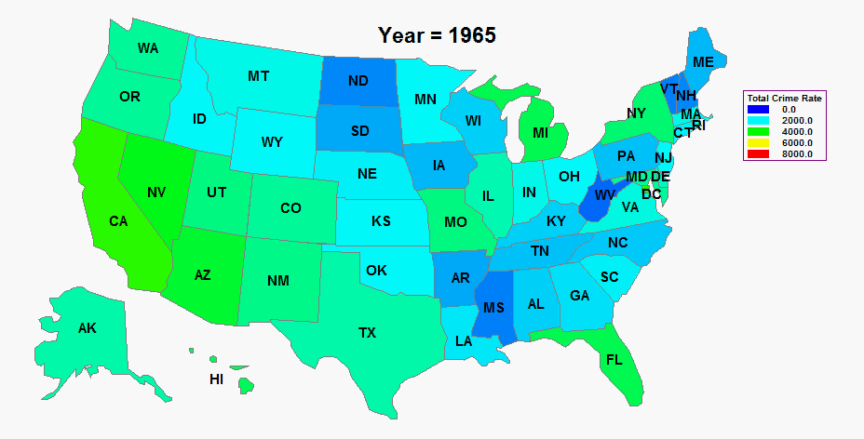
Demographic Maps

Slide 4
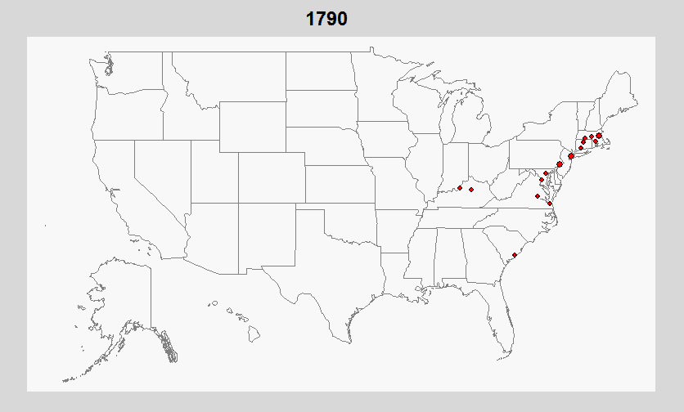
Demographic Maps

Slide 5
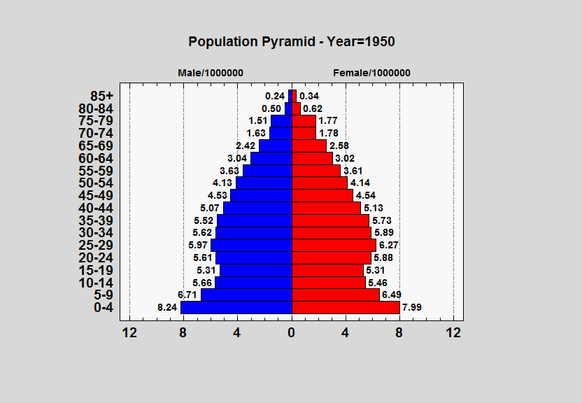
Population Pyramid

Slide 6
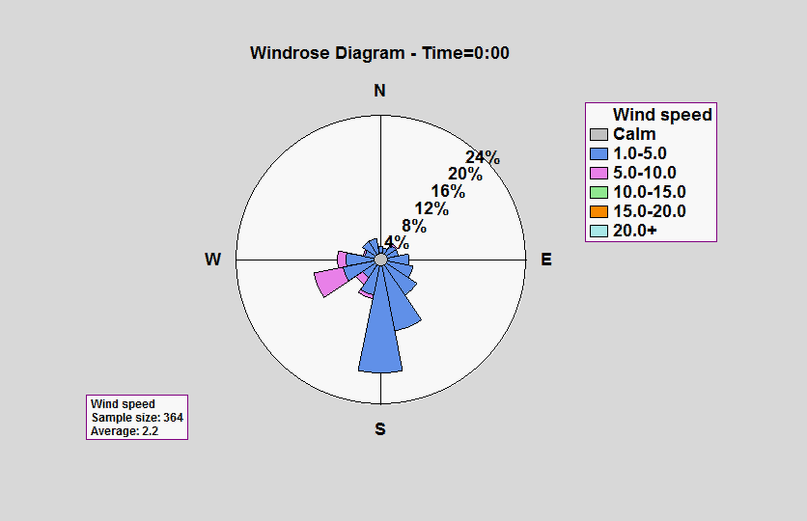
Wind Rose

Slide 7
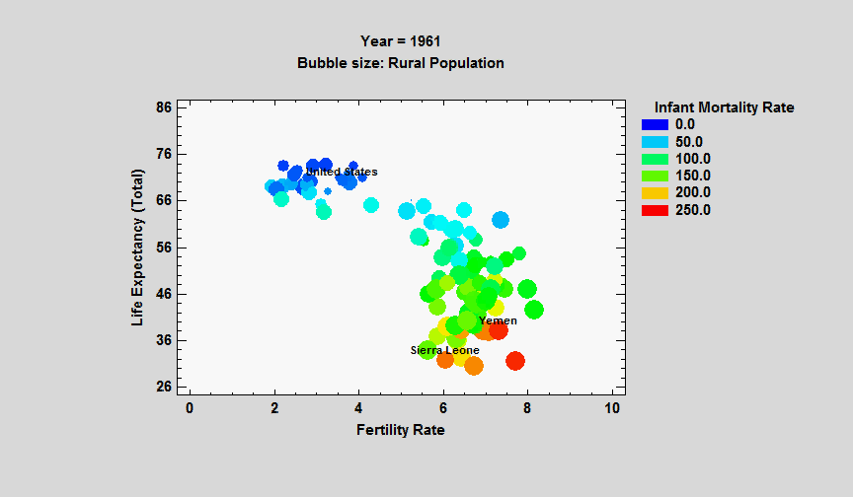
Bubble Chart

Slide 8
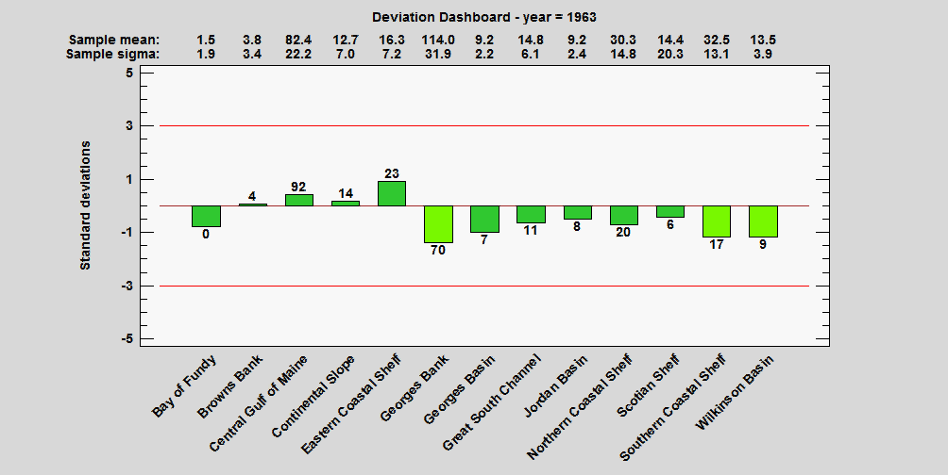
Deviation Dashboard

Slide 9
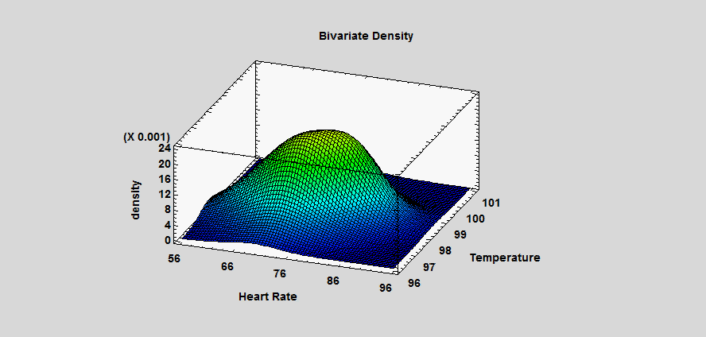
Bivariate Density Estimation

Slide 10
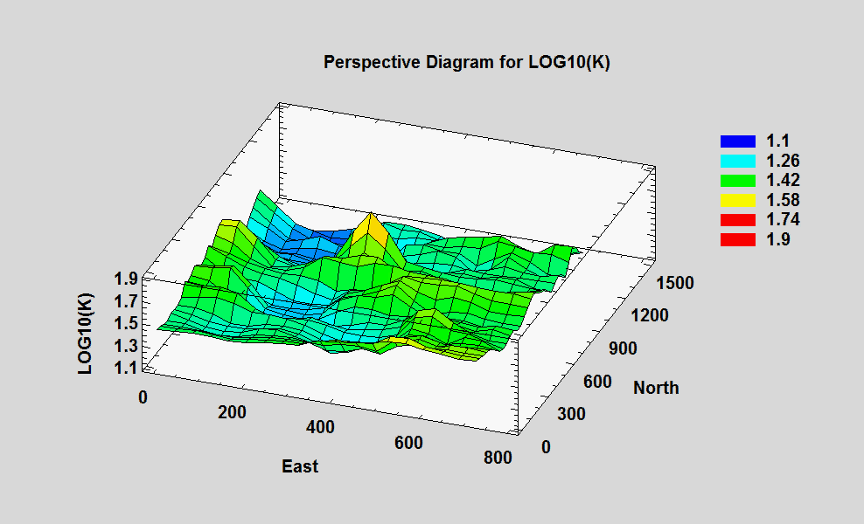
Kriging

Slide 11
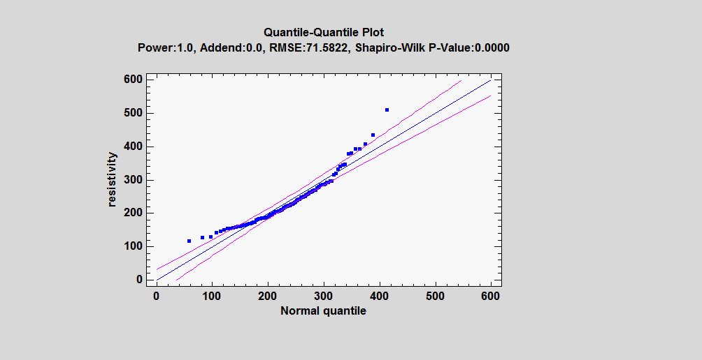
Power Transformations

Slide 12
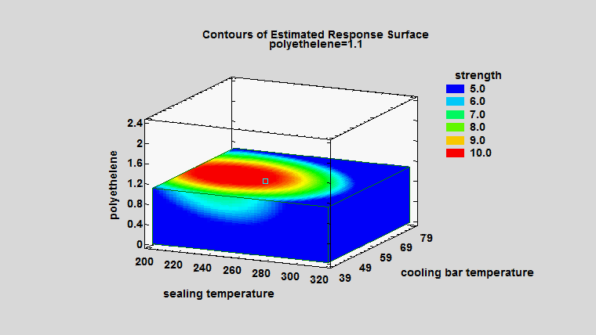
Response Surfaces

